Slide 1
CS 5393: Advanced Python Final Presentation
Stock Price Prediction using RNNs
Logan Hight

Slide 2
Project Overview
Time series forecasting using RNNs
Goals:
Accurately predict AAPL stock prices
Design model that could realistically be used in real-world financial prediction scenario
Models used:
LSTM (baseline)
GRU (baseline)
Multi-Feature GRU
GRU Activation Function Variants (ReLU, Leaky ReLU, ELU, SELU)
Each model was evaluated quantitatively and statistically

Slide 3
Why RNNs?
Able to effectively capture temporal dependencies
Can handle non-linear patterns in input data
LSTM and GRU architectures are both well-suited for sequential prediction
Resulting models will be able to scale to real-world market trends

Slide 4
Dataset & Preprocessing
AAPL data from Jan. 2010 to Nov. 2023
Input features:
Closing price initially
Added daily trading volume later in modeling process
Input data normalized using MinMaxScaler
Sliding-window sequences:
Length = 60 days → predict day 61
80/20 train-test split

Slide 5
Modeling Workflow
Define model architecture
Compile with MSE loss function and MAE as secondary metric
Optimizer: Adam (learning rate = 0.001)
Early stopping based on validation loss to prevent overfitting
Predictions were inverse-transformed to dollars

Slide 6
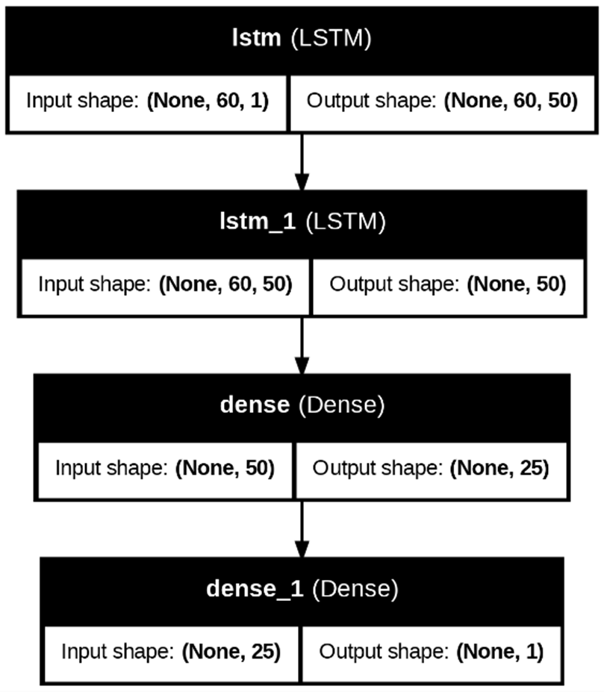
LSTM Model (baseline)
Sequential model with 2 stacked LSTM layers
Dense (25) → Dense (1) for price output
Used only close price as input
Baseline for future comparison

Slide 7
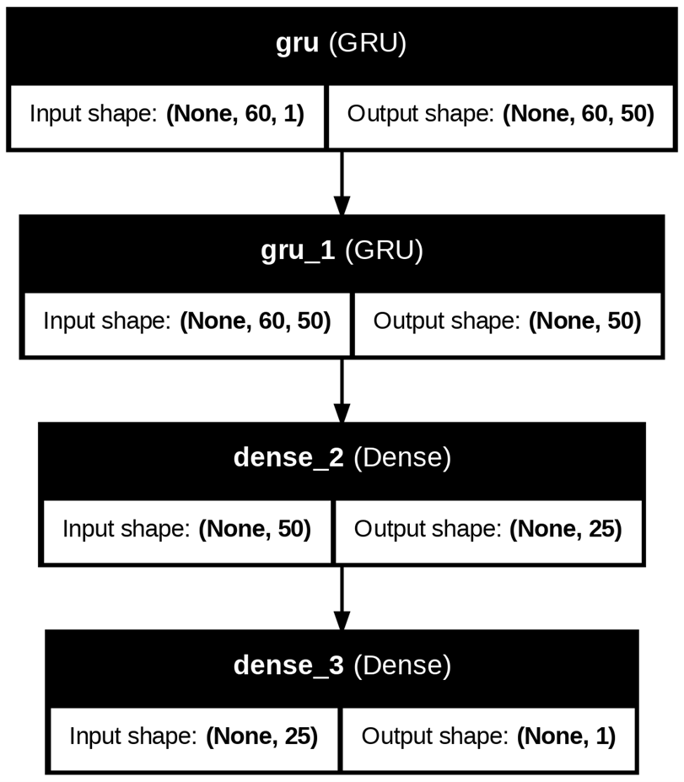
GRU Model (Baseline)
Similar structure to LSTM model
GRU advantages:
Fewer parameters
Faster training
Used only close price as input
Dual purpose:
Comparison to LSTM model
Baseline for future GRU models

Slide 8

Multi-Feature GRU Model
Same architecture as baseline GRU model
Volume added as second input feature
Input dimensionality increased:
Increased training time?
Better prediction accuracy?

Slide 9
GRU Activation Function Variants
Same architecture and input features as Multi-Feature GRU model
Default activation functions replaced to test impact on performance
ReLU:
Can improve gradient flow and model convergence
Applied in GRU and dense layers
Leaky ReLU:
Allows a small gradient for negative inputs → avoids “dying ReLU” problem
Applied in dense layers
ELU:
Can enable better learning dynamics for negative values
Applied in all layers
SELU:
Allows for self-normalization → improves training stability
Applied in all layers

Slide 10
Evaluation Metrics
RMSE
Penalizes large errors heavily
Contextual importance since large errors present significant financial risk
MAE
Represents average absolute dollar error in prediction
Easy to interpret for stakeholders
Also recorded model training and prediction time
Used statistical testing to validate results

Slide 11
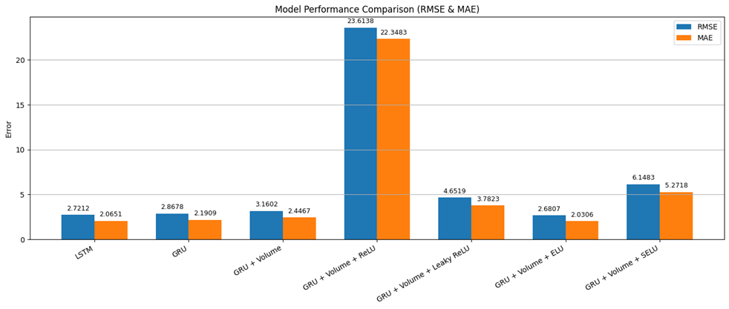
Performance Comparison (RMSE & MAE)
Best: GRU ELU (RMSE = 2.68; MAE = 2.03)
Addition of volume initially increased error
Activation function choice had a large impact on performance

Slide 12
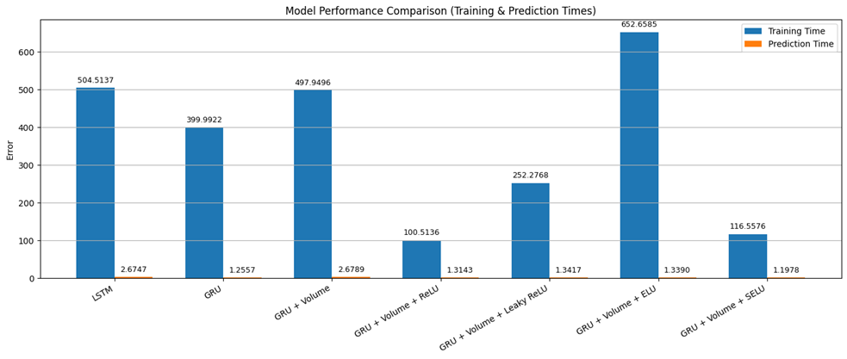
Performance Comparison (Training & Prediction Times)
Majority of GRU models trained faster than LSTM
All models had reasonable performance times
Again, activation function choice had a large impact on performance

Slide 13
Statistical Testing
Paired t-test on all model combinations on MAE
All shown to have statistically significant difference, except:
GRU ELU and LSTM (p = 0.145)
Wilcoxon signed-rank test on all model combinations on prediction distributions
All shown to have statistically significant differences
Even those that had similar average errors!
Shows that all models make systematically different forecast decisions

Slide 14
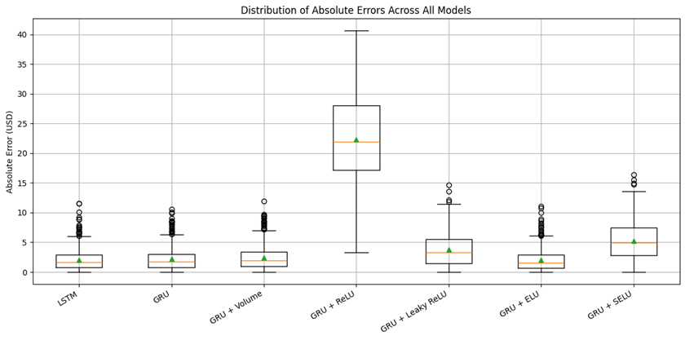
Absolute Error Distribution
GRU, Multi-Feature GRU, and GRU ELU – low medians and compact IQR
LSTM – also low median and compact IQR, but more upper outliers
Once again, activation function choice had a large impact on performance

Slide 15
Final Recommendation – GRU ELU Model
Lowest RMSE and MAE
Consistent performance across entire price and time range
Clear superiority to models with similar average error performance
Better runtime and stability
~50% faster prediction time than LSTM model
ELU improves gradient flow and effectively handles negative activations
Validated to have significant performance differences from all other models

Slide 16
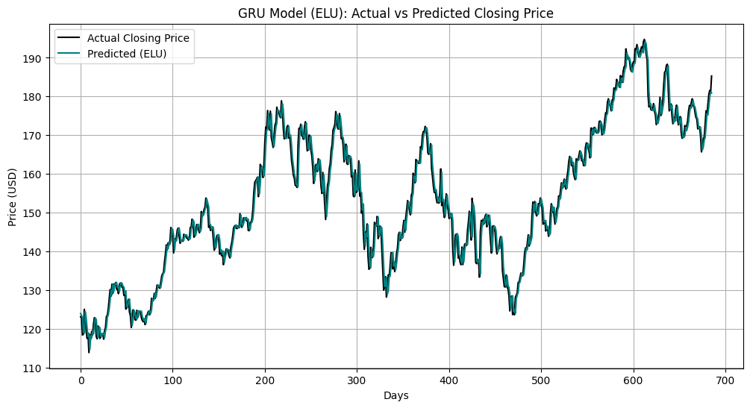
GRU ELU Model – Actual vs Predicted Closing Price
Accurately captures global trends and local inflection points

Slide 17
Summary
GRU ELU model suitable for:
Daily stock trend forecasting
Portfolio adjustment and trading strategy systems
Retail finance tools that support investor decision-making
Future work:
Add input features or tickers
Try alternate architectures (transformers, hybrid, etc.)
Portfolio-level prediction

Slide 18
Thank you!
Questions?

